Slide 1
KYC Automation Team Lenders

Slide 2
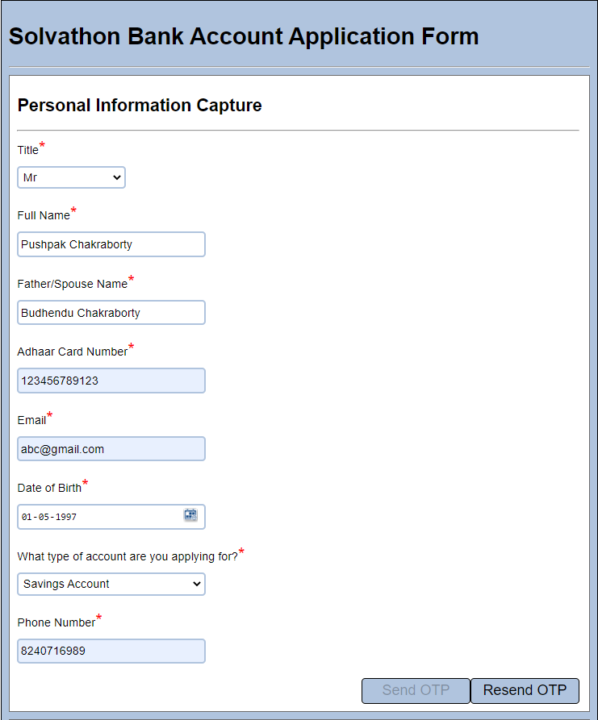
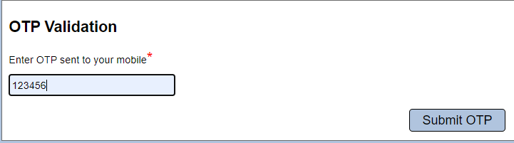
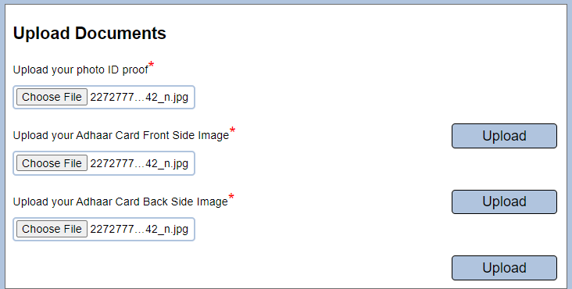
User Experience

Slide 3
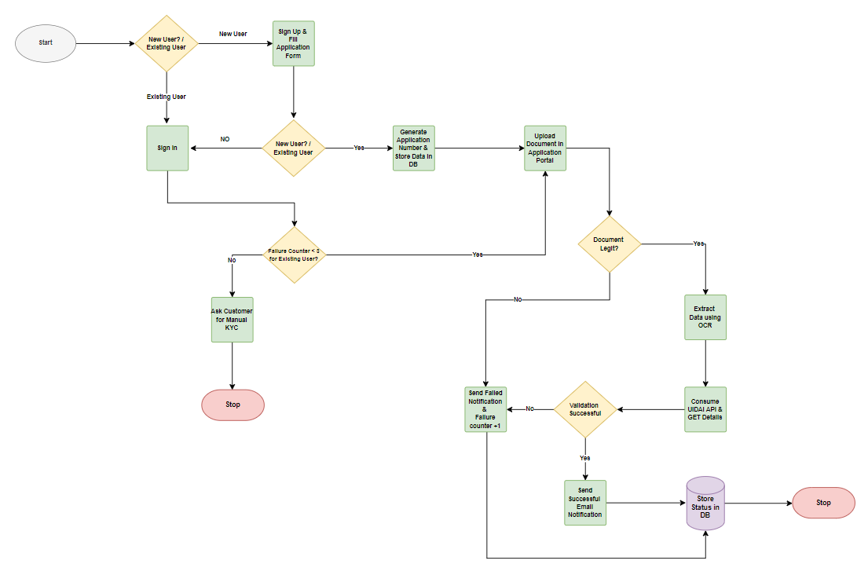
Technology & Innovation(Architecture)

Slide 4
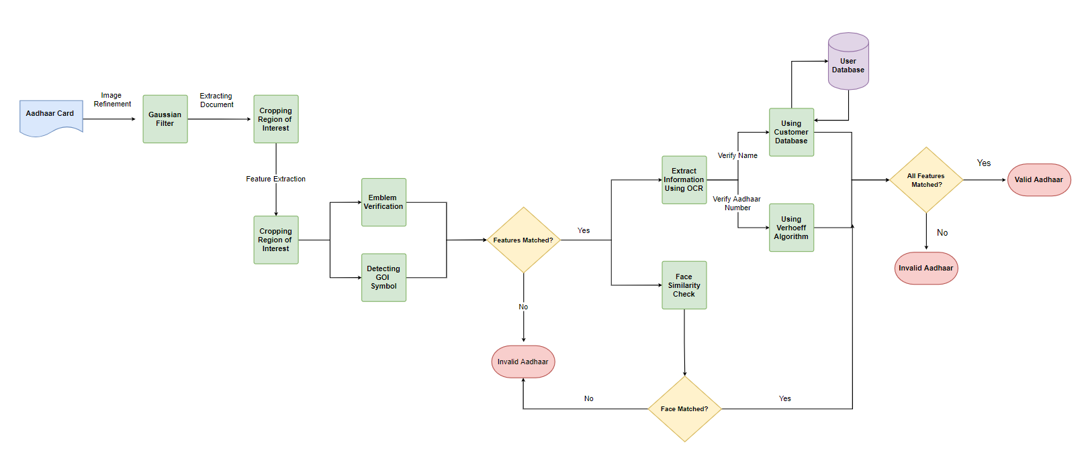
Technology & Innovation(Model Architecture)

Slide 5
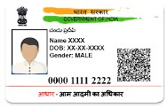
Technology & Innovation
KYC Validation
Emblem Detection
GOI Symbol
Detection
Information
Extraction
Face Similarity

Slide 6
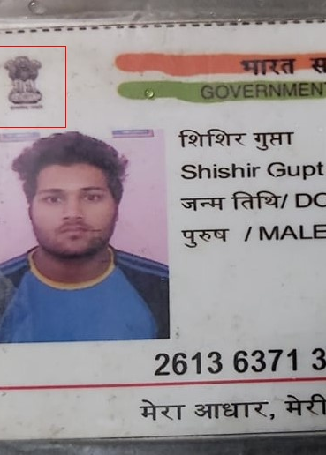
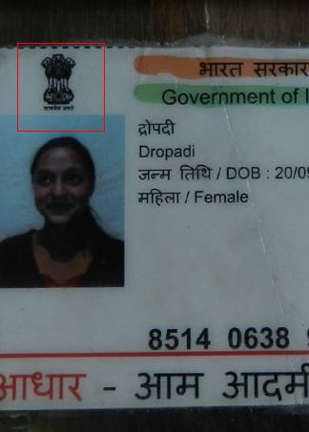
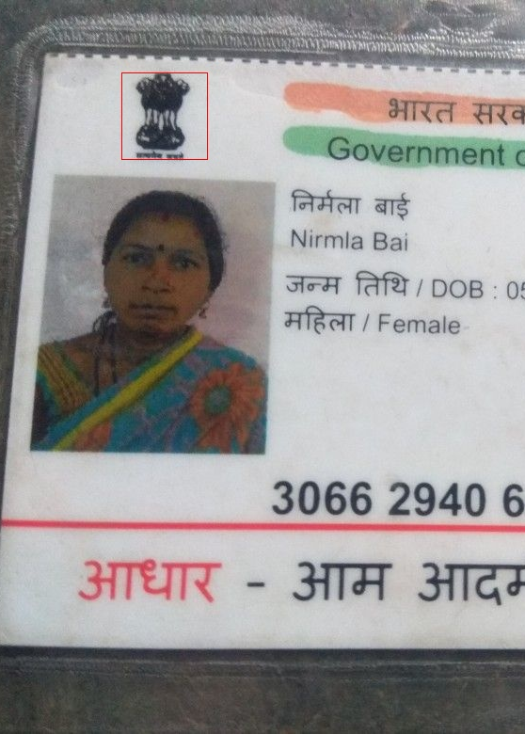
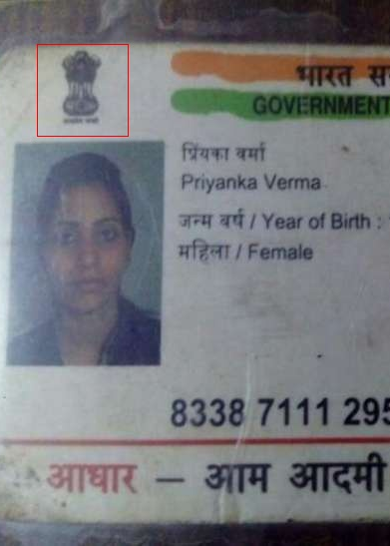
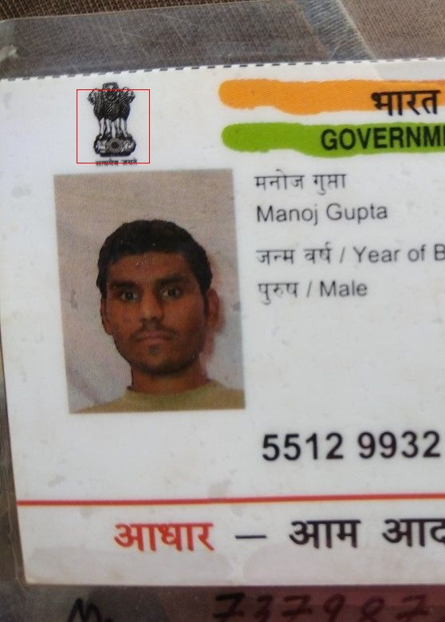
Technology & Innovation(Emblem)

Slide 7

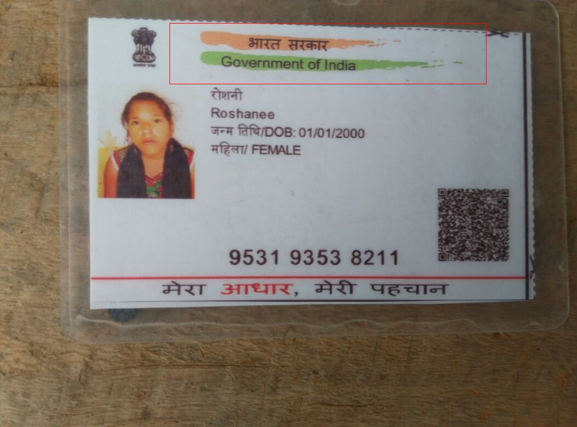
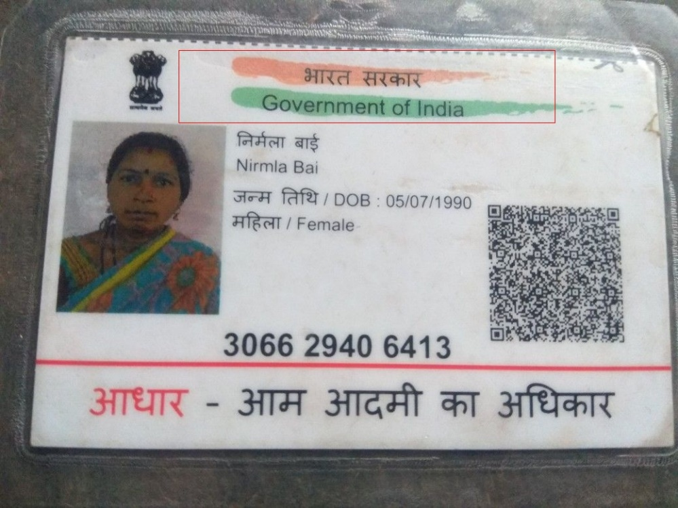
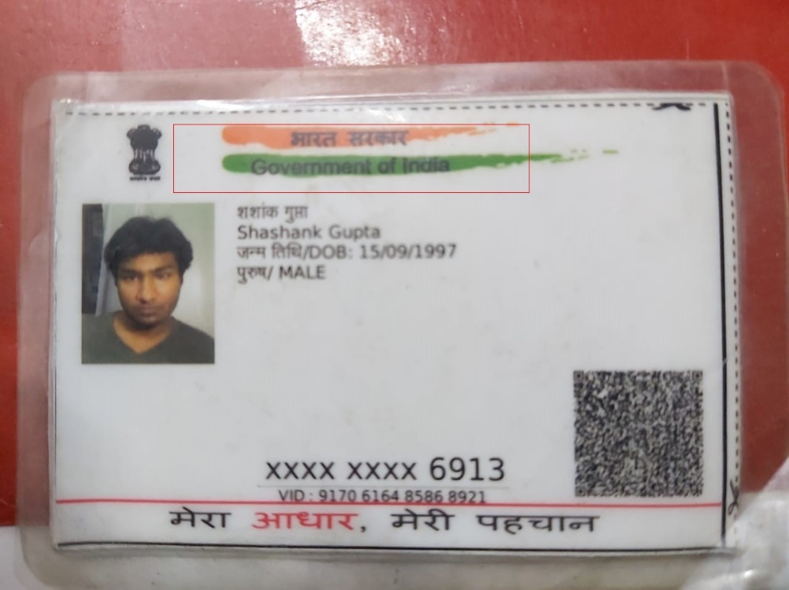
Technology & Innovation (GOI)

Slide 8
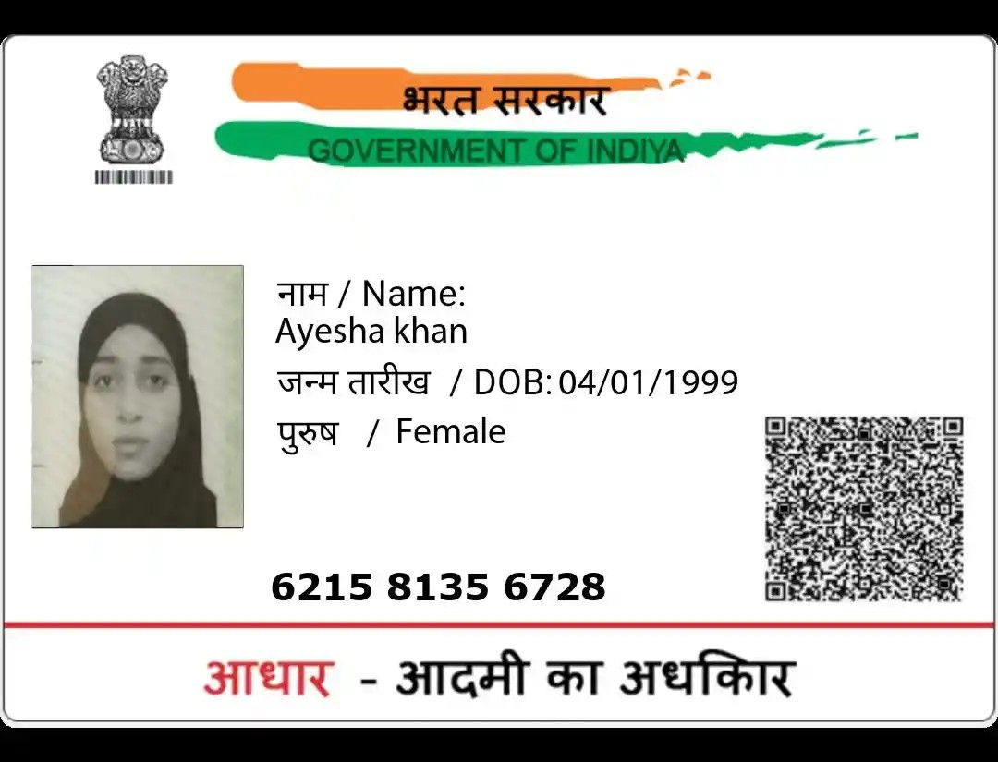
Technology & Innovation (Fake Aadhaar)
Validation | Status
Emblem | Failed
GOI | Failed
Aadhaar Number | Failed

Slide 9

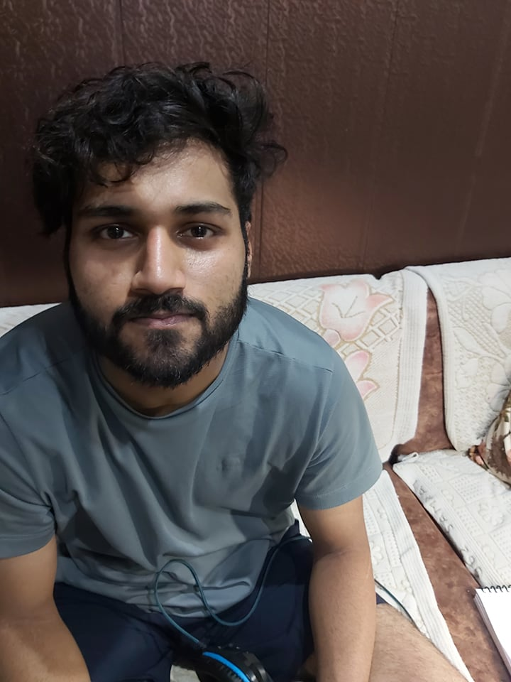
Technology & Innovation(Face Similarity)
Performed Face Similarity on LFW (Labeled Faces in the Wild) dataset and achieved 95% accuracy in identifying the similar faces.
Total Number of Images | Matched | Unmatched
901 Incorrect Pairs | 32 | 869
901 Correct Pairs | 849 | 52
72% Matched

Slide 10
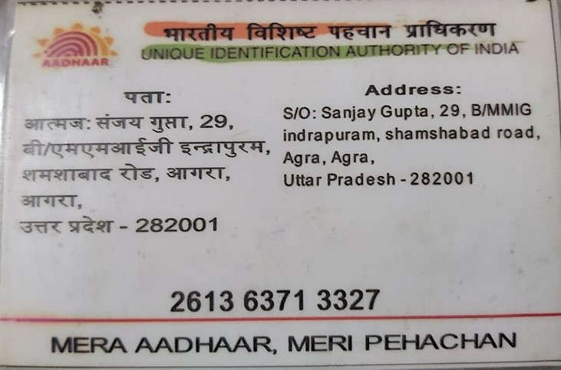
Technology & Innovation(OCR)
Details | Extracted Data
Name | Shishir Gupta
DOB | 01/02/1999
Gender | MALE
Aadhaar Number (UID) | 2613 6371 3327
Father’s Name | Sanjay Gupta
Address | BMMIG INDRAPURAM
Pin code | 282001

Slide 11
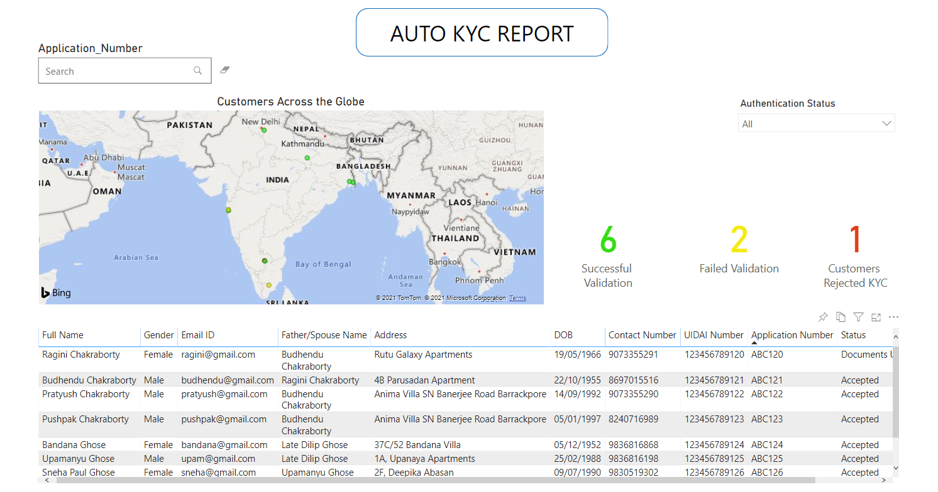
Value Add
Auto KYC Report
Auto KYC Demo

Slide 12
Execution
Efforts | Time Consumed (in Hrs)
Python Models | 15
API Development | 4
Frontend Application | 8
Backend Connections | 9
Database Creation/ Queries | 3
Documentations & Flow Diagram | 5
Testing & Debugging | 6
Demo Recording | 0.5
PPT | 2

Slide 13
Business Value
Following are the benefits of our KYC automation solution:
Requires no manual intervention
Low KYC approval time (30 seconds/per KYC)
Notifies the user by emailing the KYC status
Requires OTP authentication for enhanced security
Lower chances of frauds
Provides demographics of KYC cases via Power BI reports
User Friendly
Maintained a database with customer details

Slide 14
Technical Feasibility & ROI
Eliminating Manual Intervention
Cost Reduction per KYC
Lower KYC Validation Time
Increased Customer Satisfaction
Enhanced Security

Slide 15
Future Scope
Milestones | Description
Replace HTML, Java Script, JQuery with Angular/React. | Build responsive application using advance frameworks
Can consider masked Aadhaar as an Input from UIDAI Website. | Ability to handle masked Aadhaar in the document upload section
Take picture inputs from Webcam | Ability to capture applicant’s image from Webcam directly
Scanning the QR code | Scanning the QR Code for extracting the applicant’s details directly
Adding more Identification proofs for KYC | Add PAN/Passport/DL for KYC Verification
Email Verification | Add Email verification for better security
Aadhaar UIDAI Symbol Validation | Verification of Aadhaar UIDAI symbol from back of Aadhaar
Power BI reports (Risk Profiling) | Create Power BI reports based on Customer Details Data for Analysis

Slide 16
Thank You

